Slide 1
Climate change Be part of the solution!

Slide 2
GREENHOUSE GASES
Carbon Dioxide (CO₂)
Methane (CH₄)
Nitrous oxide(N₂O)
Fluorinated gases

Slide 3
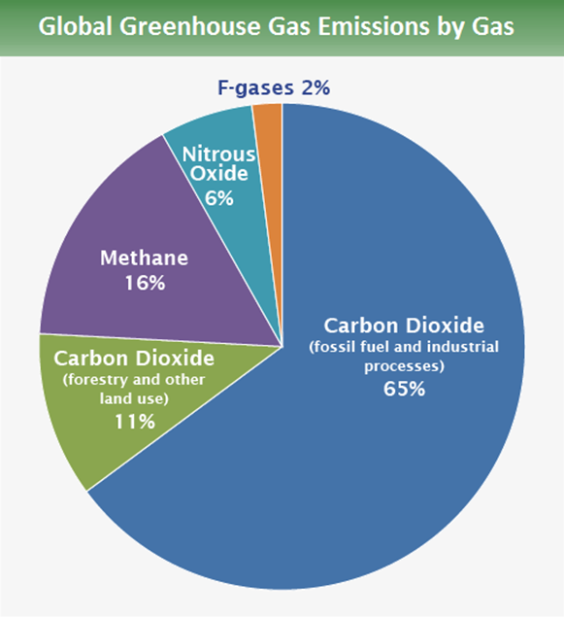
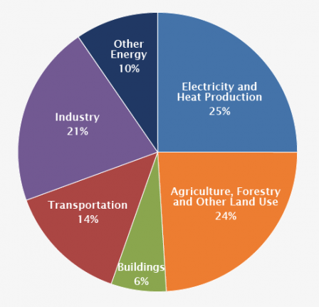
GLOBAL GREENHOUSE EMISSIONS BY GAS AND BY SECTOR
Source: IPCC (2014); based on global emissions from 2010.

Slide 4
ENERGY PRODUCTION (heat and electricity)
Traditional energy production (with combustion of fossil fuels) is responsible for 25% of global emissions of greenhouse gases.
Reduce your household´s energy use
Contract green energy suppliers
Produce your own green power
Reduce the consumption of goods and devices

Slide 5
REDUCING HOUSEHOLD´S ENERGY USE
Unplug your appliances when they're not in use
Choose an energy-efficient fridge
Buy window seals.
Wash at 30 degrees instead of 40 (saves about 0.2-0.15kWh per cycle)
Shade your windows during summer days (specially in Seville!!)
Use a programmable timer and thermostat controls for cooling and heating
Use a programmable timer if you have a electric water heater
Check your refrigerator and freezer temperature (specially on your holidays or when you are going to be out for a few days).
Install low energy lights

Slide 6
SPANISH GREEN ENERGY SUPPLIERs
Your decision will encourage renewable energy projects at the national level, and also at the local level.
COOPERATIVES ( Invest in their own renewable energy projects) :
SOM ENERGIA https://www.somenergia.coop/es/
ECONACTIVA https://econactiva.es/
ENERGETICA COOP https://energeticacoop.es/quienes-somos/
PRIVATE COMPANIES:
GANA ENERGÍA: https://ganaenergia.com/tarifas-luz/
LUCERA ENERGÍA https://lucera.es/

Slide 7
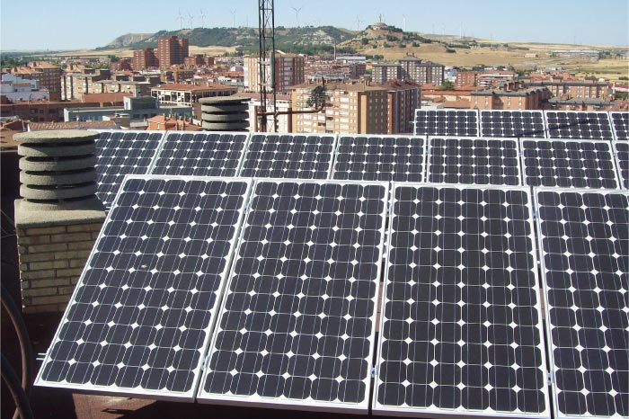
PRODUCING YOUR OWN ENERGY
there are companies AND COOPERATIVES that provide technical advice and installation projects for GREEN electricity production in neighborhoodS AND communities
https://econactiva.es/placas-solares-comunidad-vecinos/

Slide 8
TRANSPORT
Transportation of people and goods is responsible for 14% of global greenhouse emissions. Most modes of transport (plane, vehicles, ship, train) consume fossil fuels or electricity produced by the combustion of fossil fuels.
Colective means of transport vs individual
Train
Bus
Carpooling
Bla bla car
Plan a no-fly holiday
Look for different locations you can reach by train
Look around. You may not have explored your own region
Avoid connections when you travel by plane
Cycling

Slide 9
Some examples
If you fly twice a year, flying may be a large portion of your carbon footprint.
https://co2.myclimate.org/es/flight_calculators/new?allow_cookies=true
The carbon footprint of a house for a monthly consumption of 200 kwh (2400 kwh a year) with a ratio of 0,3090 kg Co2 e/Kwh it would imply a footprint of 0,46 t of Co2 eq.
The carbon emissions of only one flight would be 5 times higher than the emissions associated with your electricity bill or equivalent to the emissions associated with traveling 15,000 km per year by car.
https://calculator.carbonfootprint.com/calculator.aspx?lang=es&tab=4

Slide 10
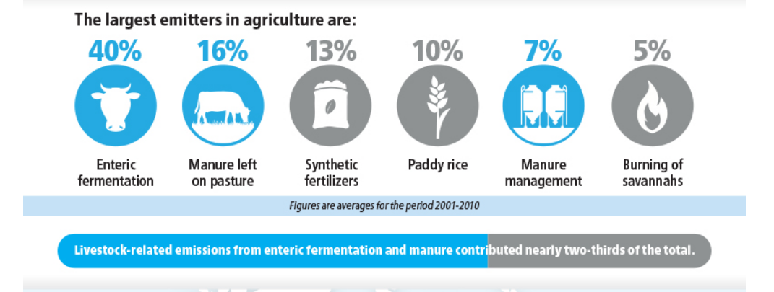
AGRICULTURE AND LIVESTOCK

Slide 11
Meat consumption
Reduce or avoid
Buy local products
Consume local, organic and seasonal fruits and vegetables
Fair trade Organic Direct suppliers
Local organic shops
Buy just the exact amount you are going to consume
Buy organic meat
Colective gardening

Slide 12
FAIR TRADE LOCAL ORGANIC SUPPLIERS
sevilla
MAS QUE LECHUGAS (https://masquelechugas.com/)
MECOLOGICO (http://www.mecologico.es/)
DIETA ECOLÓGICA (http://www.dietaecologica.com/)
ENREDAOS CON LA TIERRA http://enredaosconlatierra.org/
ORGANIC CONSUMERS ASSOCIATION
La ortiga https://laortiga.com/
La Regüerta ecológica http://lareguertaecologica.blogspot.com/p/quienes-somos.html
Red de Sevilla Ecoartesana https://sevillaecoartesana.wordpress.com/como-se-participa/

Slide 13
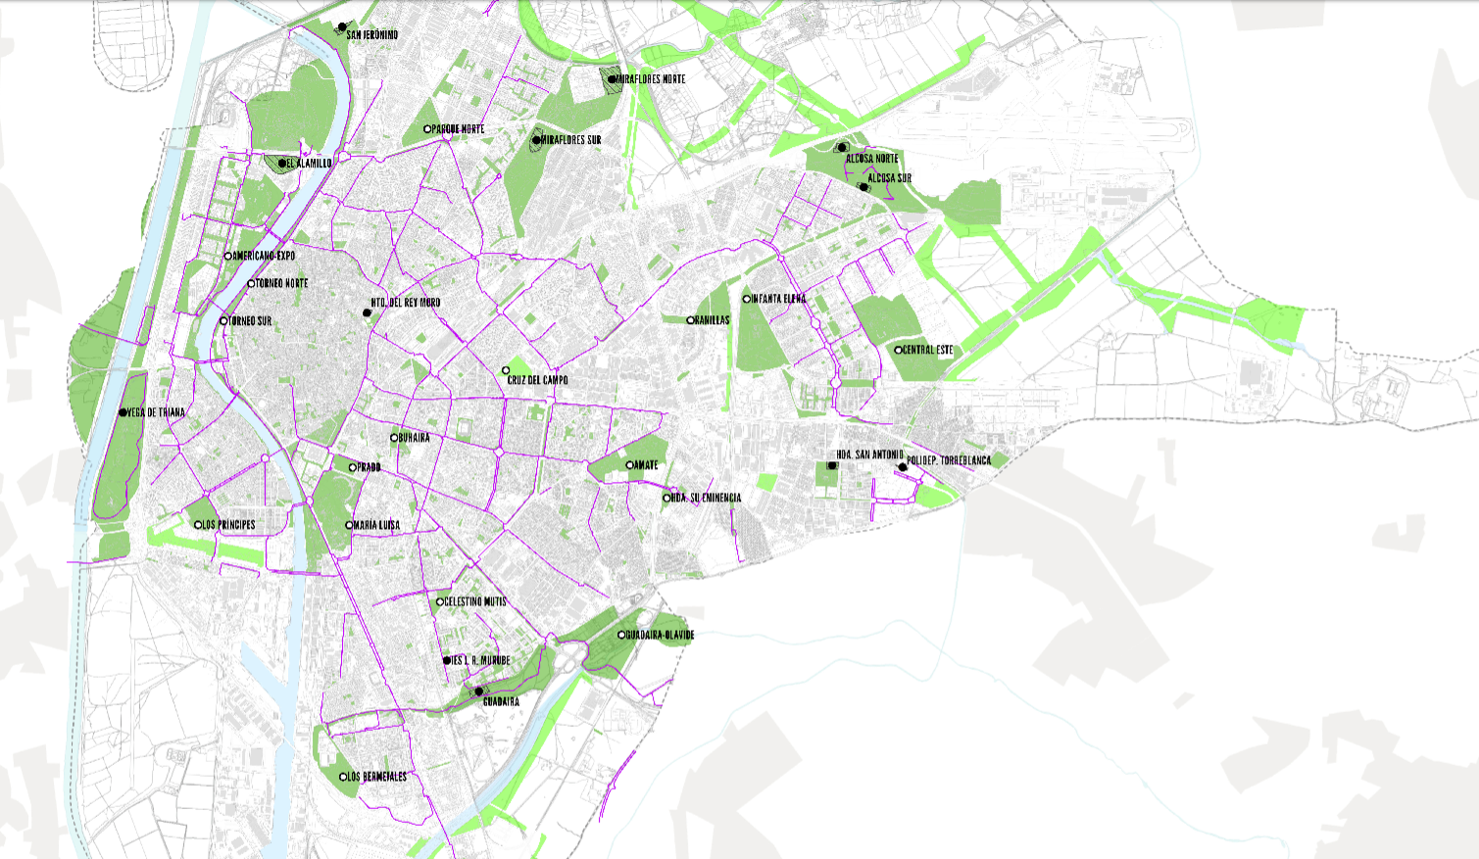
COLLECTIVE GARDENING
https://huertosurbanosevilla.wordpress.com/

Slide 14
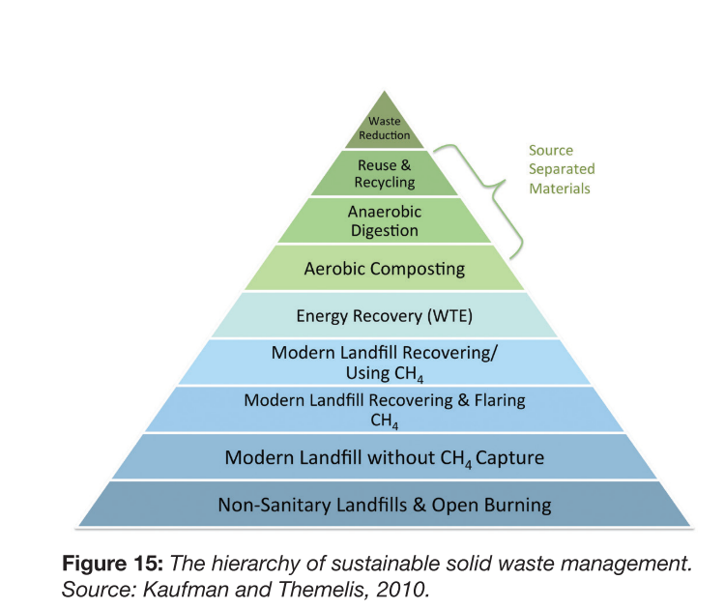
WASTE
The production of waste is linked to the consumption of goods.
GHG emissions of waste are associated with:
Incineration (with or without energy recovery)
Other waste treatment operations
Landfill (production of CH4)

Slide 15
Reduce packaging
Avoid online shopping for goods you can buy in local shops
Reduce unnecessary consumption
Buy loose food
Reduce disposable plastic

Slide 16
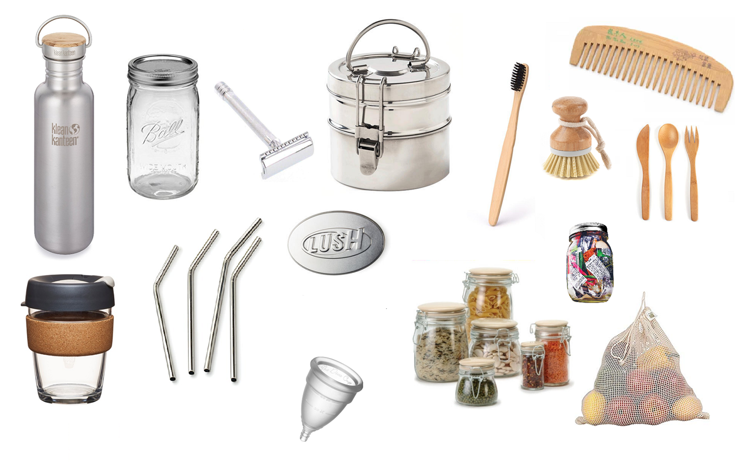
ZERO WASTE STARTER PACK

Slide 17
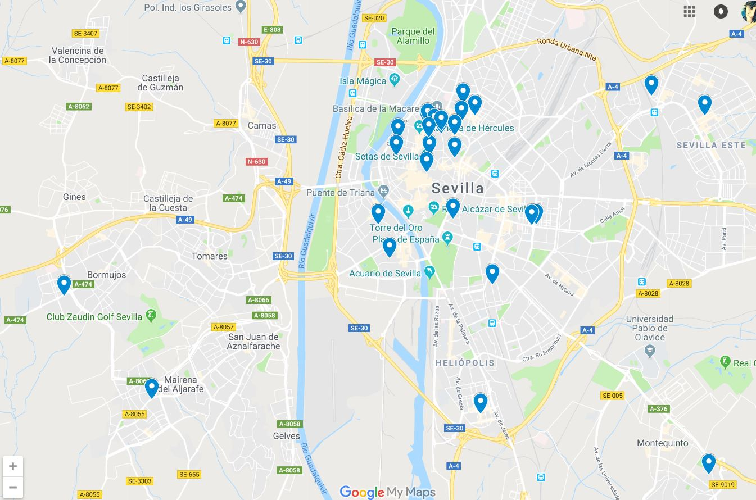
SEVILLA´S ZERO WASTE MAP
https://www.google.com/mymaps/viewer?mid=1V91T6MgjWR6TJIn-eE7vlQme4fZkSoUs&hl=es

